Slide 1



Energy Disaggregation
Georgara Vasiliki 21107
Tserpe Paraskevi 21117

Slide 2


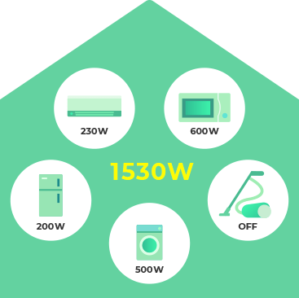
What is energy disaggregation?
Non-intrusive load monitoring (NILM) or energy disaggregation is a computational technique for estimating the power demand of individual appliances from a single meter which measures the combined demand of multiple appliances.

Slide 3




NILM Benefits
helps users reduce their energy consumption
helps operators to manage the grid
identifies faulty appliances
survey appliance usage behavior

Slide 4
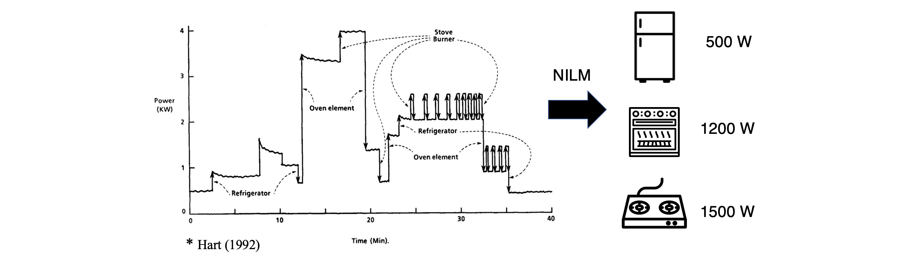
Dataset
Public data set, termed the Reference Energy Disaggregation Data Set (REDD)
Power data from 6 houses in the Boston area collected in the summer of 2011
Low frequency data, /sec for a mains and /3 sec for the circuits

Slide 5

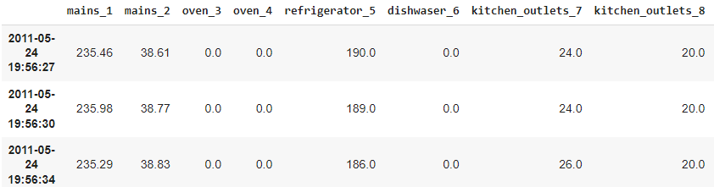
Dataset Preparation
House 1 data contain 23 days from 2011-04-18 to 2011-05-24.
['2011-04-18', '2011-04-19', '2011-04-20', '2011-04-21', '2011-04-22', '2011-04-23', '2011-04-24', '2011-04-25', '2011-04-26', '2011-04-27', '2011-04-28', '2011-04-30', '2011-05-01', '2011-05-02', '2011-05-03', '2011-05-06', '2011-05-07', '2011-05-11', '2011-05-12', '2011-05-13', '2011-05-22', '2011-05-23', '2011-05-24']

Slide 6
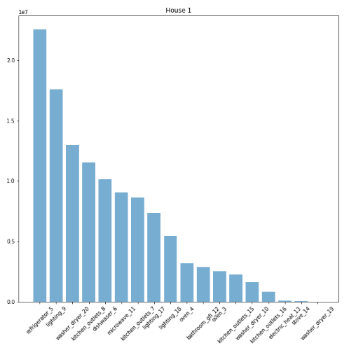
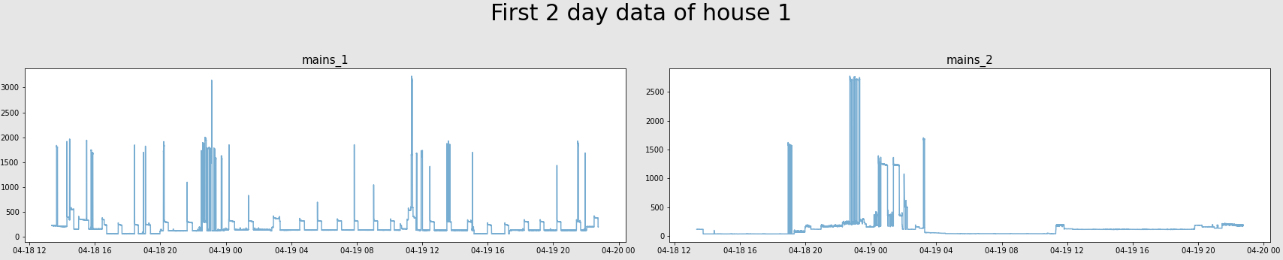
Dataset
Preparation

Slide 7
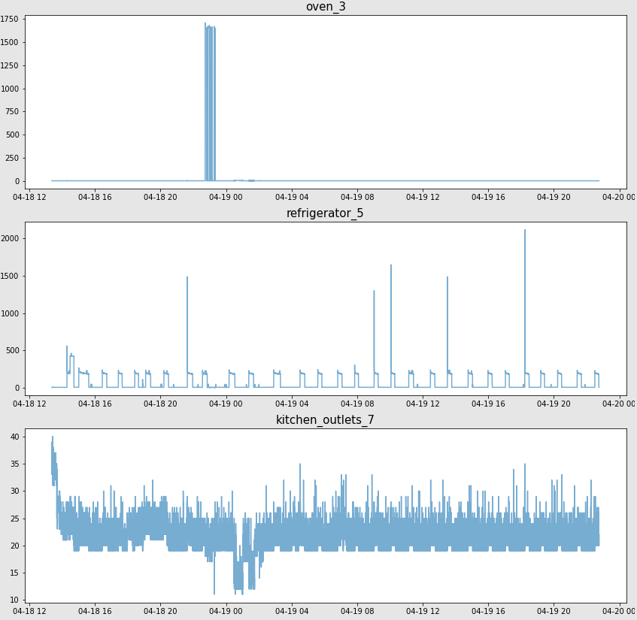
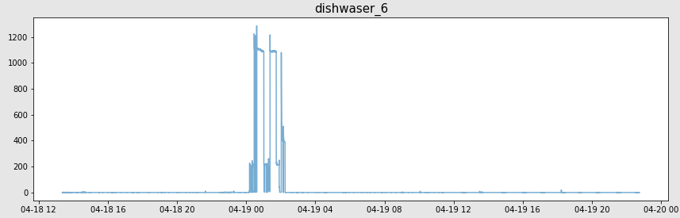
Dataset
Preparation

Slide 8
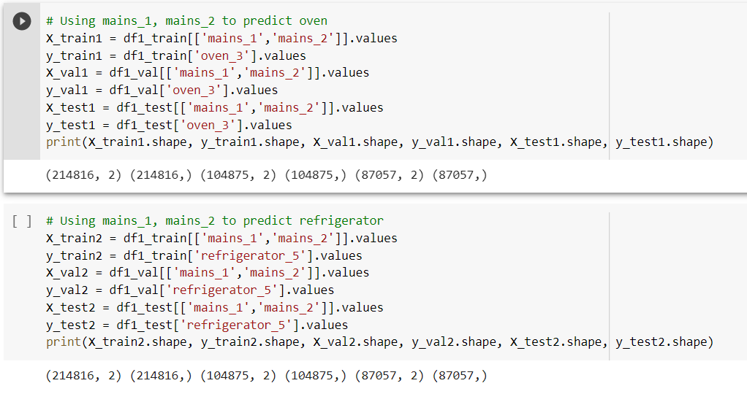
Training, validation and test data

Slide 9
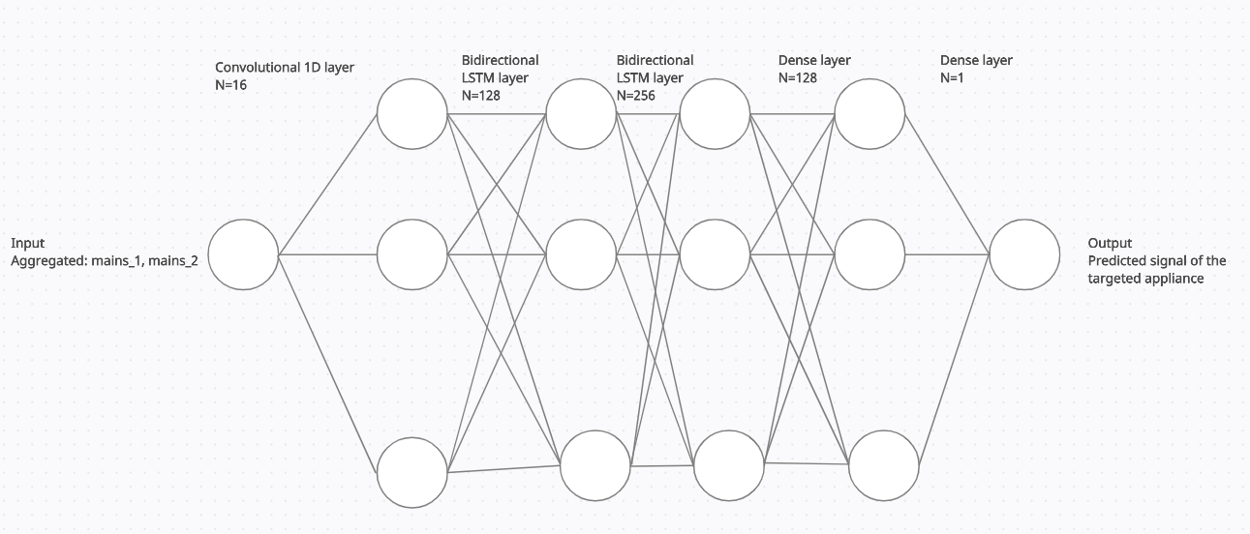
Algorithm

Slide 10
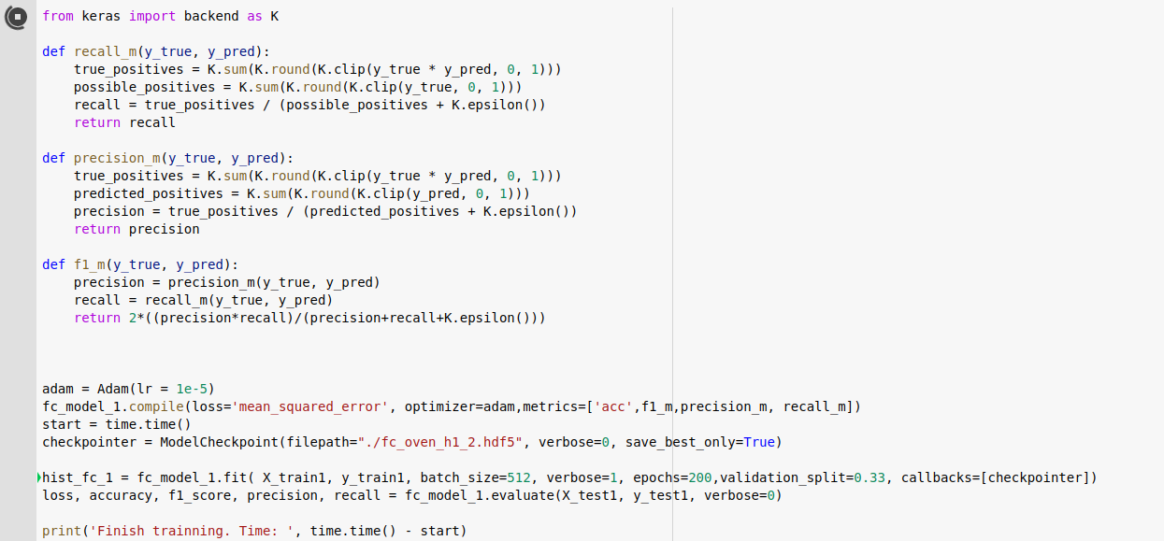
Metrics

Slide 11
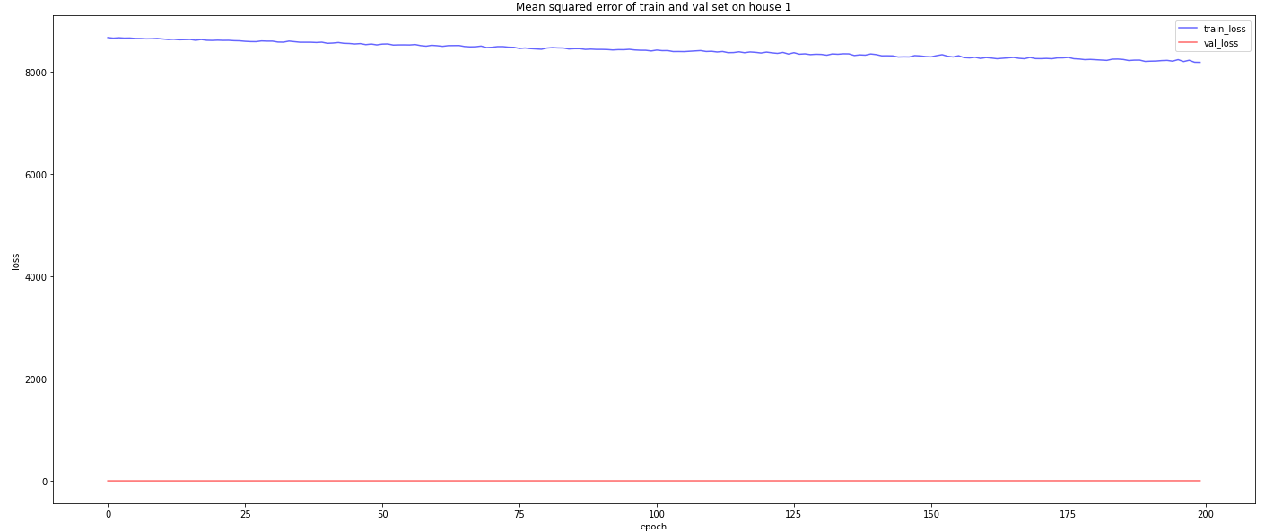
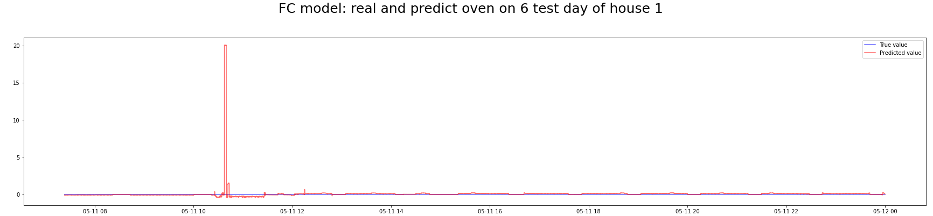
Results
oven

Slide 12
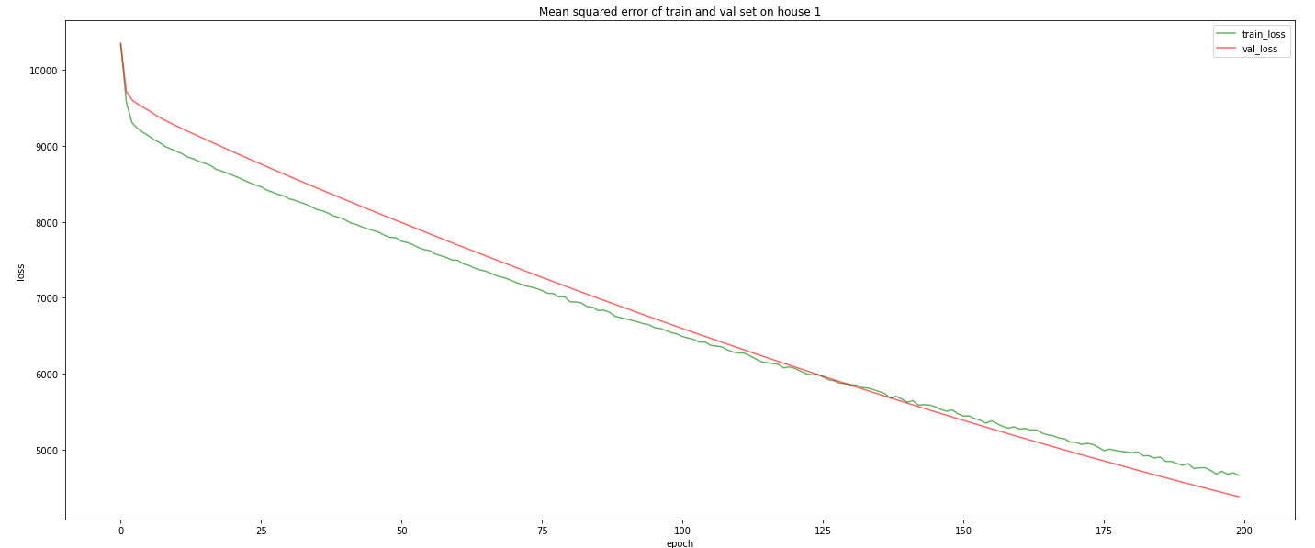
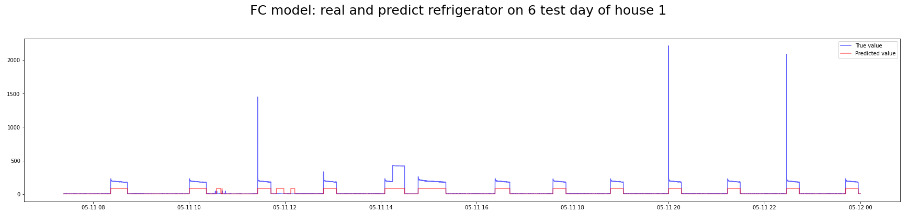
Results
refrigerator

Slide 13
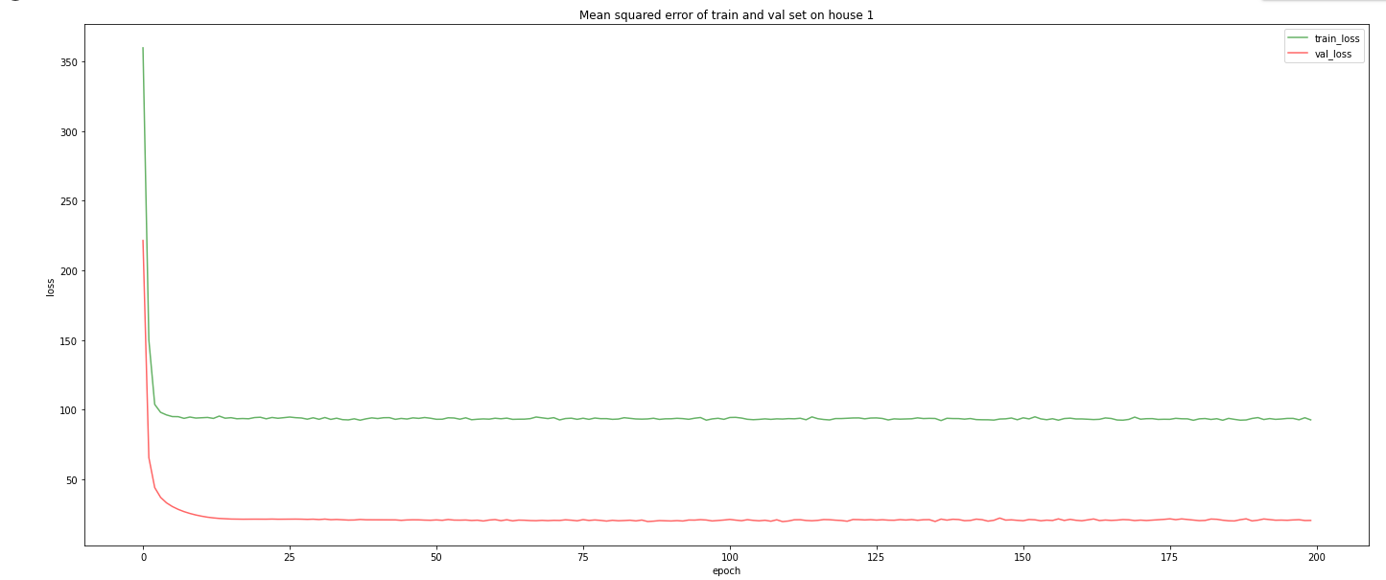
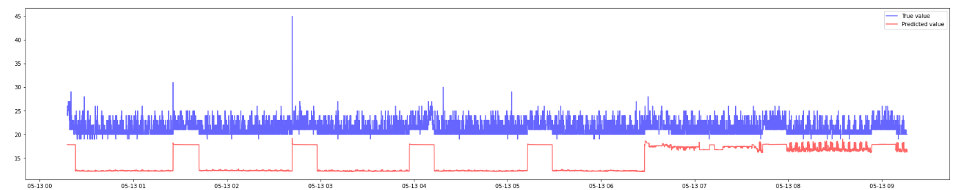
Results
kitchen outlets

Slide 14
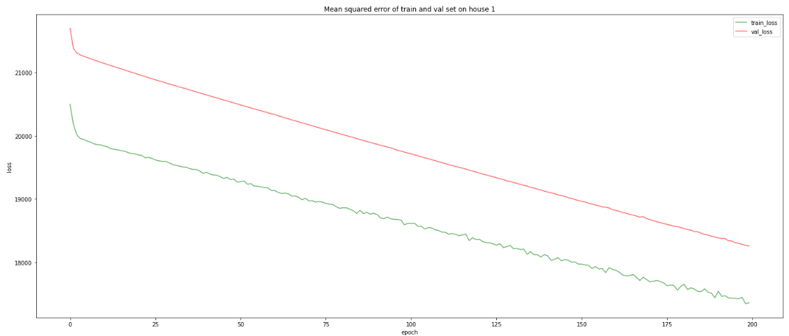
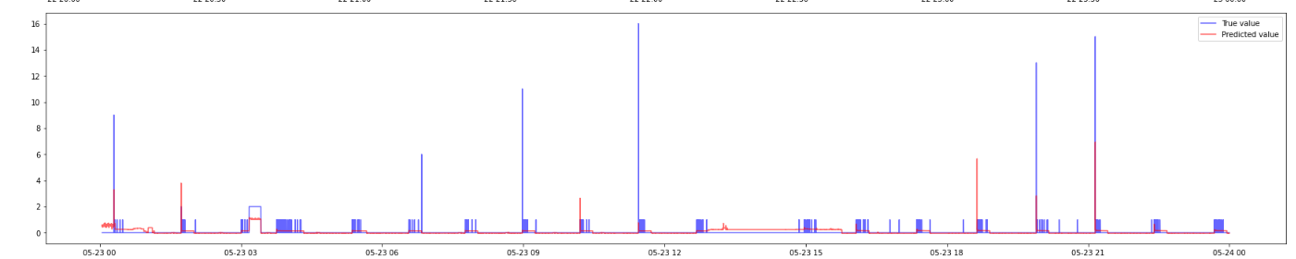
Results
dishwasher

Slide 15
Conclusion
The tested prediction had good results, mostly for appliances that appeared as a periodic waveform, e.g., the refrigerator.
Other appliances that had an on/off usage, seemed to have been predicted less accurately.
Performance was better on multi-state devices than on two-state devices.

Slide 16
Future work
Validate the error rate of a model that would predict if the appliance is always on/always off.
More experiments should be executed considering the number of neurons in CNN, and Dense layers
Study more houses in REDD dataset.

Slide 17



